Slide 1

Theory of cost

Slide 2
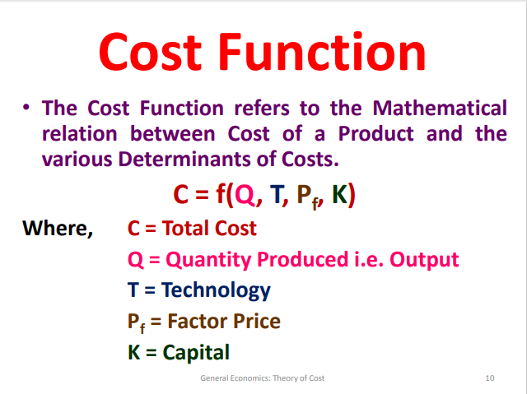
Cost Function

Slide 3
Determinants of Cost Function
Several factors influence the shape and behavior of the cost function:
1. Level of Output (Q):
As production increases, costs generally increase due to higher input usage. Economies of scale may lower the cost per unit for large-scale production.
2. Input Prices (P_L, P_K, etc.):
The cost of labor, capital, and raw materials directly affects total costs. Higher input prices increase production costs and shift the cost function upward.
3. Technology (T):
Technological improvements can increase efficiency, reducing the amount of inputs needed for production, thereby lowering costs.

Slide 4
Determinants of Cost Function
Several factors influence the shape and behavior of the cost function:
1. Level of Output (Q):
As production increases, costs generally increase due to higher input usage. Economies of scale may lower the cost per unit for large-scale production.
2. Input Prices (P_L, P_K, etc.):
The cost of labor, capital, and raw materials directly affects total costs. Higher input prices increase production costs and shift the cost function upward.
3. Technology (T):
Technological improvements can increase efficiency, reducing the amount of inputs needed for production, thereby lowering costs.

Slide 5
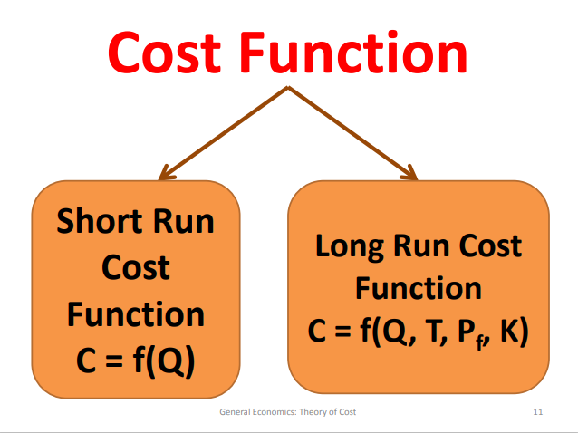
Types of Cost Function

Slide 6
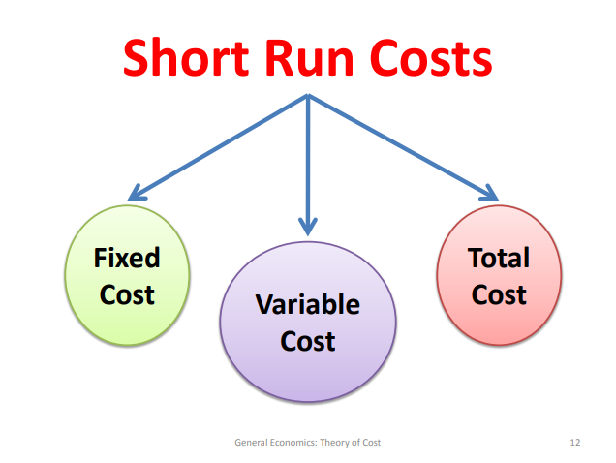

Slide 7
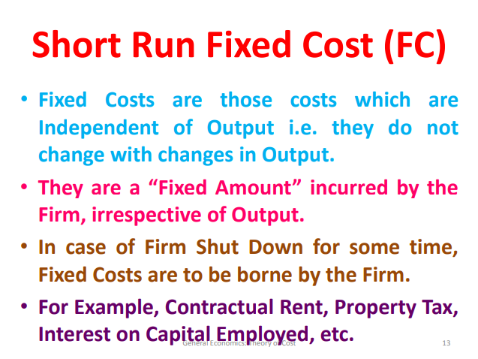
Short run Cost Function

Slide 8
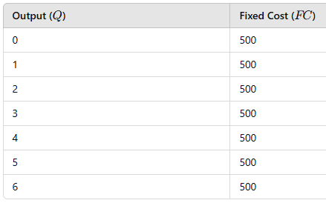
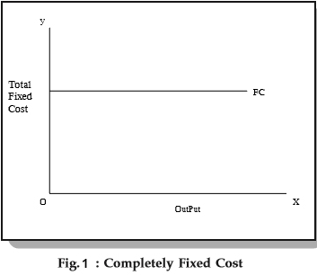
Short run Cost Function

Slide 9
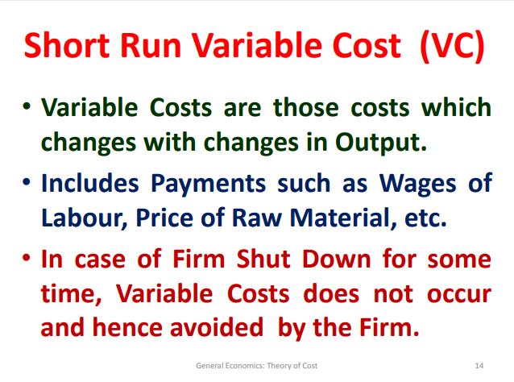
Short run Cost Function

Slide 10
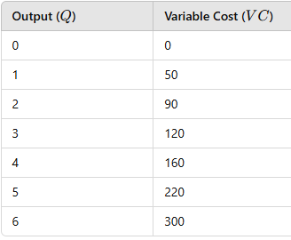
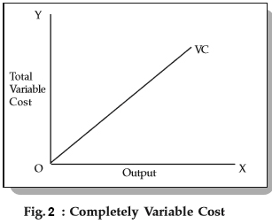
Short run Cost Function

Slide 11
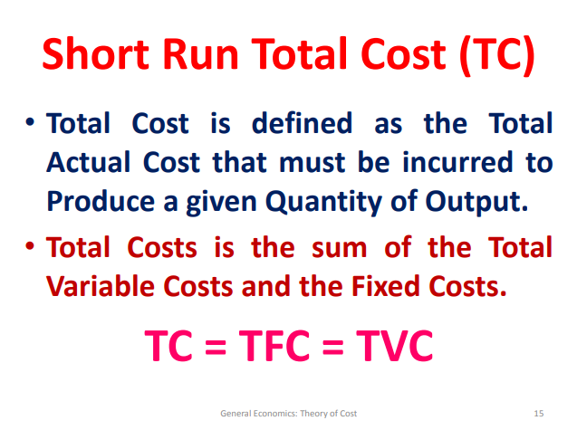
Short run Cost Function

Slide 12
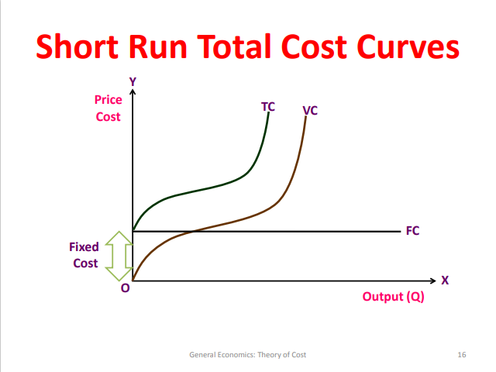
Short run Cost Function

Slide 13
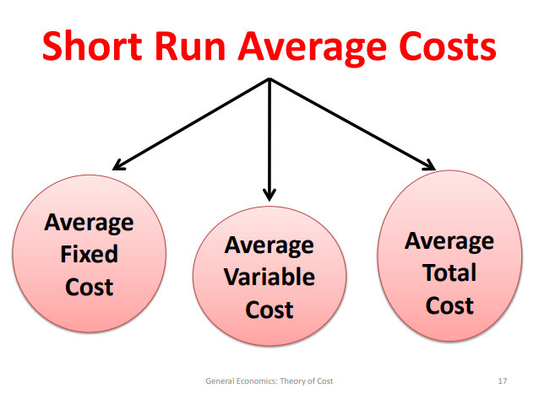
Short run Cost Function

Slide 14
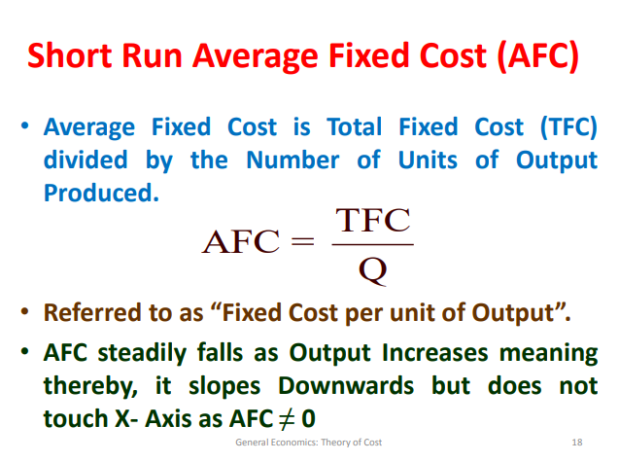
Short run Cost Function

Slide 15
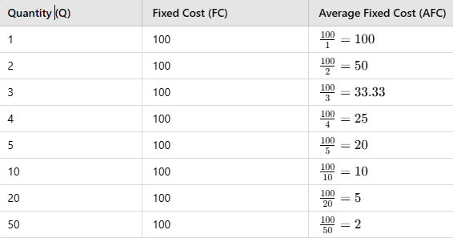
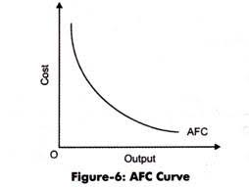
Short run Cost Function

Slide 16
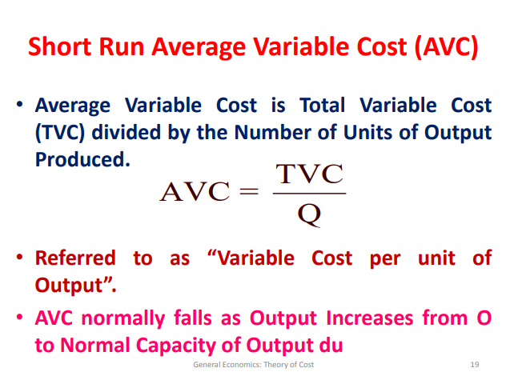
Short run Cost Function

Slide 17
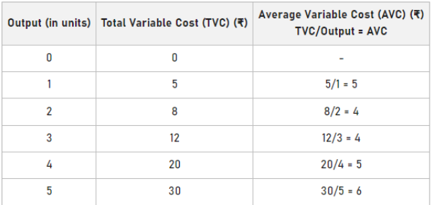
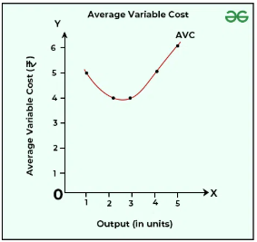
Short run Cost Function

Slide 18
Short run Cost Function
Reason for the U shaped AVC:
The Law of Diminishing Marginal Returns explains why AVC increases at higher levels of output.
Early Stages of Production:
  Initially, adding more variable inputs (e.g., labor) to a fixed input (e.g., machinery) increases productivity. As a result, variable costs rise slowly, and AVC decreases.
Later Stages of Production:
  As more units of variable input are added, the fixed input becomes overused or inefficient.
  The additional output produced by each extra unit of input (marginal product) declines.
  Variable costs increase faster than output, causing AVC to rise.

Slide 19
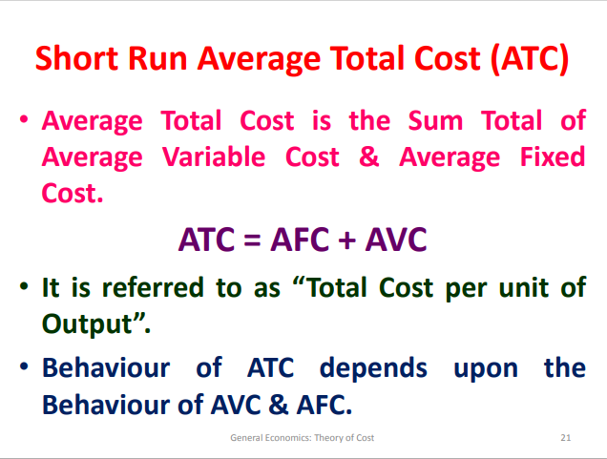
Short run Cost Function

Slide 20
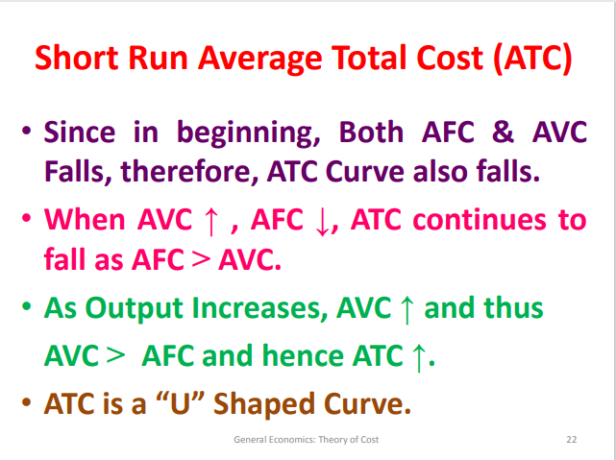
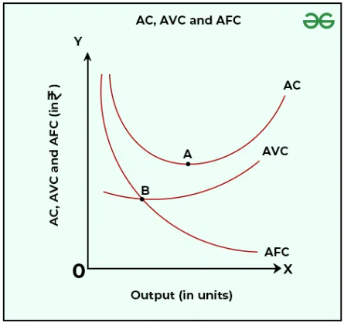
Short run Cost Function

Slide 21
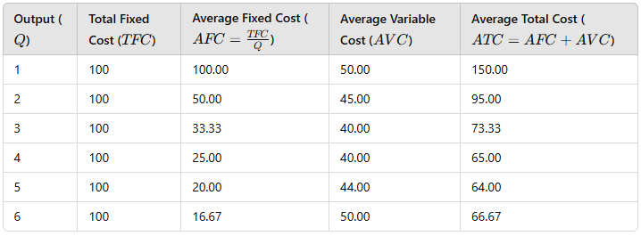
Short run Cost Function

Slide 22
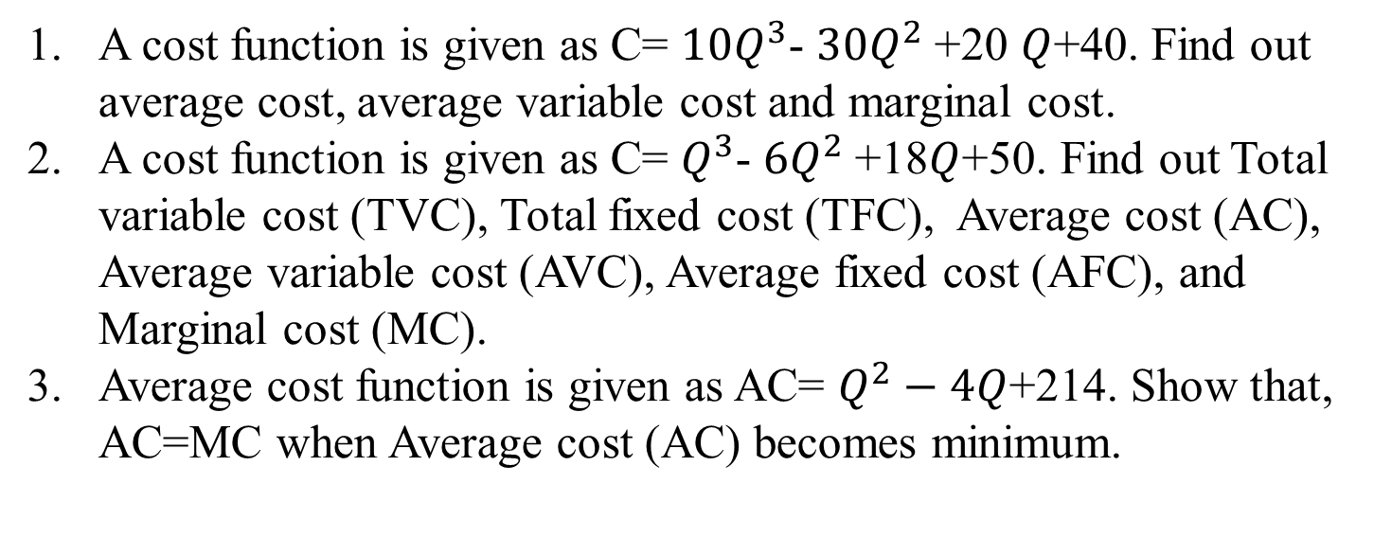
Mathematical problems on Cost Function

Slide 23

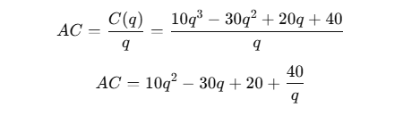
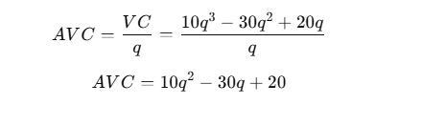
Mathematical problems on Cost Function
1.

Slide 24
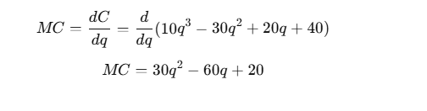
Mathematical problems on Cost Function

